Slide 1

Chapter 10 Electromagnetic Radiation and Principle
Wuqiong Luo

Slide 2
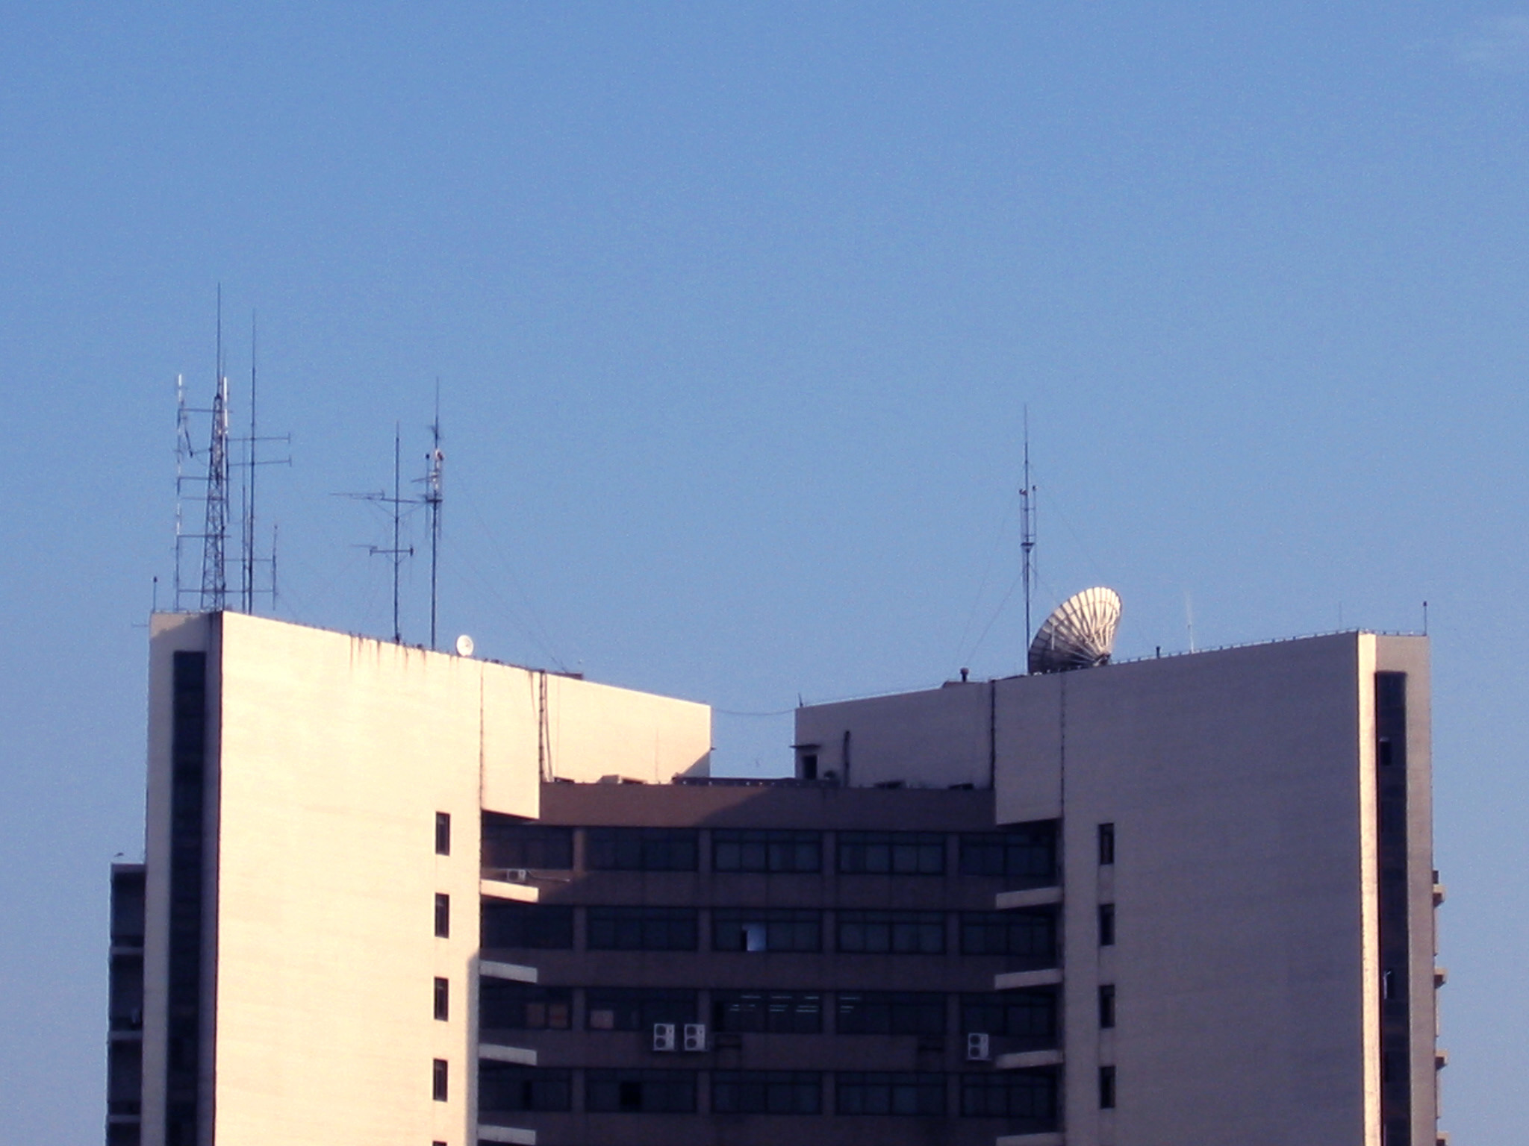
Linear antennas
Surface antennas

Slide 3

Electric Current Element,
Directivity of Antennas
Linear Antennas, Antenna array
Principle of Duality,
Principle of Image,
Principle of Reciprocity
Huygens’ Principle, Aperture Antennas.

Slide 4
Antenna: Structures designed for radiating electromagnetic energy effectively in a prescribed manner.

Slide 5
Parameters
Parameters of Antenna
Directivity
Main beam-width
Side-lobe level
Gain
Polarization
Input impedence
Frequency and bandwidth

Slide 6
Radiation
Electric current element
Surface electric current
1. Radiation by Electric current Element
A segment of wire carrying a time-varying electric current with uniform amplitude and phase is called an electric current element or an electric dipole.
I
l
d
and d << l，l << λ ，l << r。
Most of radiation properties of an electric current element are common to other radiators.

Slide 7
Assume that the electric current element is placed in an unbound dielectric which is homogeneous, linear, isotropic and lossless.
Radiation
Select the rectangular coordinate system, and let the electric current element be placed at the origin and aligned with the z-axis.
z
ε , μ
P(x, y, z)
We know that
r
Il
o
y
x
It is very hard to solve them directly, and using vector magnetic potential A
where

Slide 8
Due to we can take ；
The electric current element has z-component only, , and
For radiation by an antenna, it is more convenient to select the spherical coordinate system, and we have
z
A_{z}
ε , μ
A_{r}
θ
Using gives
-A_{θ}
θ
r
Il
y
φ
x

Slide 9
From or ，we find the electric fields as
The fields of a z-directed electric current element have three components: , , and only, while .
The fields are a TM wave.

Slide 10
In summary, we have
Fields
z
E_{r}
ε , μ
H_{φ}
θ
r
E_{θ}
Il
y
φ
x
r << λ is called the near-field region, and where the fields are called the near-zone fields.
r >> λ is called the far-field region, and where the fields are called the far-zone fields.
The absolute length is not of main concern. The dimension on a scale with the wavelength is as the unit determining the antenna characteristics.

Slide 11
Near-zone field (quasi-static field ):
Fields
Since and , the lower order terms of can be omitted, and , we have
Comparing the above equation to those for static fields, we see that they are just the magnetic field produced by the steady electric current element Il and the electric field by the electric dipole ql .
The electric field and the magnetic field have a phase difference of , so that the real part of the complex energy flow density vector is zero.
The energy is bound around the source, and accordingly the near-zone fields are also called bound fields.

Slide 12
Far-zone field:
Fields
Since and , the higher order terms of can be neglected, we only have and as
Where is the intrinsic impedance of around medium.
The far-zone field has the following characteristics:
(a) The far-zone field is the electromagnetic wave traveling along the radial direction r . It is a TEM wave and .
(b) The electric and the magnetic fields are in phase, and the complex energy flow density vector has only the real part. It means that energy is being transmitted outwardly, and the field is called radiation field.

Slide 13
Fields
(c) The amplitudes of the far-zone fields are inversely propor-tional to the distance r. This attenuation is not resulted from dissipation in the media, but due to an expansion of the area of the wave front.
(d) The radiation fields are different in different directions, and this property is called the directivity of the antenna.
The portion of the field intensity expression that describes the elevation θ and the azimuthal φ dependence is called the directivity factor, and is denoted by f (θ, φ ) .
For the z-directed electric current element, .
(e) The directions of the electric and the magnetic fields are independent of time, and the radiation fields are linearly polarized.
The above properties (a), (b), (c), and (d) are common for all antennas with finite-sizes.

Slide 14
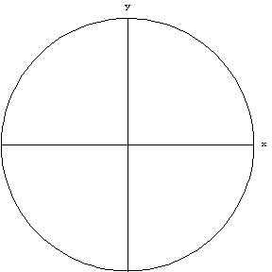
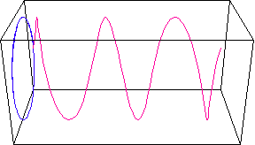
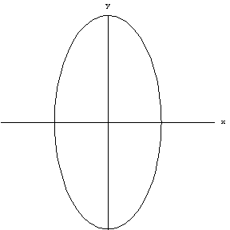
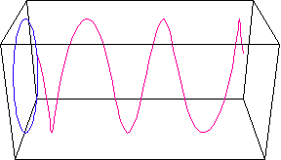
Different antenna types produce radiation fields of differing polarizations. Antennas can produce linearly, circularly, or ellip-tically polarized electromagnetic waves.
Polarization
The polarization properties of the receiving antenna must match that of the received electromagnetic wave.
Circular polarized wave
Elliptical polarized wave

Slide 15
To calculate the radiation power P_{r} , we take the integration of the real part of the complex energy flow density vector over the spherical surface of radius r in the far-field region, as given by
Power
Where S_{c} is the complex energy flow density vector in the far-field region, i.e.
We find
If the medium is vacuum, Z = Z₀ = 120π Ω, the radiated power is obtained as
where I is the effective value of the electric current.

Slide 16
Resistance
The resistive portion accounting for the radiation process may be defined as the radiation resistance , and is given by
For the electric current element,
The greater the radiation resistance is, the higher will be the power radiated for a given electric current.

Slide 17
Example. If an electric current element is placed at the origin along the x-axis, find the far-zone fields.
Example
Solution:
Since ， ， , we find
z
ε , μ
P(x, y, z)
For the far-zone fields, considering only the parts inversely proportional to the distance r we find
r
Il
O
y
x
Since the far-zone fields are TEM wave, the electric field intensity is

Slide 18
z
Example
ε , μ
P(x, y, z)
r
Il
o
y
x
For the x-directed electric current element, the directivity factor is completely different from that of a z-directed one.
The expression for the directivity factor will be different if the orientation of the antenna is changed.
However, only the mathematical expression is changed.
There is still no radiation in the direction along the axis of the electric current element, while it is strongest along a direction perpendicular to the axis.

Slide 19
2. Directivity of Antennas
Directivity
we will explore how to quantitatively describe the directivity of an antenna.
It is more convenient to use the normalized directivity factor, and it is defined as
where f_{m} is the maximum of the directivity factor .
Obviously, the maximum value of the normalized directivity factor F_{m}= 1.
The amplitude of the radiation field of any antenna can be expressed as
where is the amplitude of the field intensity in the maximum radiation direction.

Slide 20
The rectangular or the polar coordinate system is used to display the directivity pattern on a plane.
Directivity
If the electric current element is placed at the origin and aligned with the z-axis, then the directivity factor is and the maximum value . Hence, the normalized directivity factor is
In the polar coordinate system, we have
z
y
y
x

Slide 21
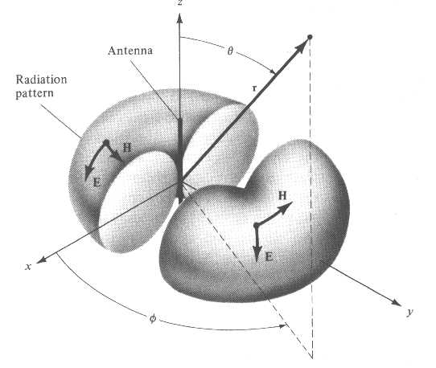
z
Electric
current
element
Directivity
θ
r
Three-dimensional direction pattern.
H
E
H
x
E
φ
y
z
The spatial directivity pattern
in rectangular coordinate system.
x
y

Slide 22
The direction with the maximum radiation is called the major direction, and that without radiation is called a null direction. The radiation lobe containing the major direction is called the main lobe, and the others are called side lobes.
Directivity
Side Lobe
Null
Direction
Main Lobe
Back Lobe
2θ ₀
2θ _{0.5}
Major Direction
1
Null
Direction
The angle between two directions at which the field intensity is
of that at the major direction is called the half-power angle, and it is denoted as . The angle between two null directions is called the null-power angle, and it is denoted as .

Slide 23
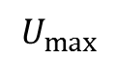
Directivity coefficient: D
Directivity
The definition is the ratio of the maximum radiation intensity to the average radiation intensity, as given by
where is the maximum radiation intensity of the directional antenna.
$$U_{max}$$
Obviously, .
The sharper the directivity is, the greater the directivity coefficient D will be.
The directivity coefficient is usually expressed in decibel (dB), as given by

Slide 24
The radiated power P_{r} of the antenna is
Directivity
where S stands for the closed spherical surface with the antenna at the center.
In terms of electric field intensity, D can be expressed as
And we find
The normalized directivity factor of the electric current element is , and we find D = 1.

Slide 25
Any real antenna has some loss, and the input power P_{A} is greater than the radiated power P_{r} .
Efficiency
The ratio of the radiated power P_{r} to the input power P_{A} is called the efficiency of antenna, and it is denoted as η , i.e.
The gain is the ratio of the maximum radiation intensity to the average power intensity if all the input power P_{i} was radiated,
If the efficiency of the omnidirectional antenna is assumed to be , we have
The gain of a large parabolic antenna is usually over 50dB.

Slide 26
3. Radiation by thin linear Antenna
The symmetrical antenna is a segment of wire carrying electric current and fed in the middle, with the length comparable to the wavelength.
Since the distribution of the current is symmetrical about the midpoint, it is called a symmetrical antenna.
z
I_{m}
If the diameter of the wire is much less than the wavelength, (d << λ ), then the dis-tribution of the electric current is appro-ximately a sinusoidal standing wave.
L
y
x
L
d
The two ends are current nodes, and the position of the maximum value depends on the length of the symmetrical antenna.

Slide 27
Suppose the half-length of the antenna is L and the antenna is placed along the z-axis, the midpoint is at the origin. Then the distribution of the electric current can be written as
z
where I_{m} is the maximum value of the standing wave of the electric current, and the constant
L
I_{m}
y
x
L
The symmetrical antenna can be con-sidered as many electric current elements with different amplitudes but the same spatial phases arranged along a straight line.
d
In this way, the radiation fields of the wire antenna can be found directly by using the far-zone fields of the electric current element.

Slide 28
The far-zone field of the electric current element is
z
P
r'
dz'
Since the viewing distance , all lines joining the electric current elements to the field point P are essentially parallel, i.e.
z'
θ
r
z'cosθ
y
x
Therefore, the directions of the far electric fields produced by all the electric current elements can be taken to be the same at the field point P, and the resultant field is the scalar sum of these far-zone fields, given by

Slide 29
Consider , so that we can take . Since the length is comparable with the wavelength, the r′ in the phase factor cannot be replaced by r. However, due to , as a first approximation, we can take
z
P
We find the far electric field as
r'
dz'
z'
θ
r
z'cosθ
y
And the directivity factor is
x
The directivity factor is also independent of the azimuthal angle φ , and it is a function of the elevation angle θ only.

Slide 30
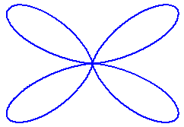
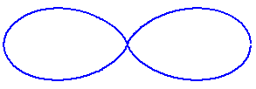
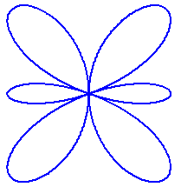
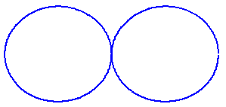
Directivity patterns of several symmetrical antennas
Half-wave
Dipole
θ
Full-wave
Dipole
2L = λ/2
2L = λ
2L = 3λ/2
2L = 2λ

Slide 31
Example. Obtain the radiation resistance and the directivity coefficient for the half-wave dipole.
Example
Solution: We know the far electric field of a half-wave dipole in free space as
And the radiated power is
From the definition of the radiation resistance , it can be written as

Slide 32
The feed (input) current is in general not the same as the maximum current on the antenna. As a result, the radiation resistance obtained using the feed current will be different from that with the maximum current.
Example
For the half-wave dipole, the feed current is just the same as the maximum current.
Substituting the normalized directivity coefficient into the following formula
Electric Current Element
We find D = 1.64.
Half-wave Dipole

Slide 33
4. Radiation by Antenna Arrays
A collection of simple antennas may be arranged to form a composite antenna, and it is called an antenna array.
By varying the number, the type of elemental antennas and their separation, along with the orientation and the amplitude and the phase of the electric currents, the desirous directivity may be obtained.
If the types and the orientations of the elemental antennas are same, they are arranged to have equal separation d along a straight line, and the amplitudes of the currents are equal, but the phases are delayed in sequential order with an amount given by α, it is called a uniform linear array .
z
P
θ
r_{n}
I e^{- j(n-1)α}
n
r₄
r₃
θ
r₂
I e^{- j3α}
4
r₁
d
θ
I e^{- j2α}
3
d
θ
I e^{- jα}
2
dcosθ
d
θ
I
1
y
x

Slide 34
z
P
If only the far-zone fields are considered, and the viewing distance is much greater than the size of the array, the lines joining the elemental antennas and the field point P can be taken to be parallel.
θ
r_{n}
I e^{- j(n-1)α}
n
r₄
r₃
θ
r₂
I e^{- j3α}
4
r₁
d
θ
I e^{- j2α}
3
d
θ
I e^{- jα}
2
dcosθ
d
θ
I
1
y
x
Since the orientation of the elemental antennas is the same, the directions of their fields are the same as well.
In this way, the resultant field of the array is equal to the scalar sum of the fields of the elemental antennas, so that

Slide 35
The radiation field of the i-th elemental antenna can be written as
For a uniform linear array, since all elemental antennas are the same, we have
As the orientations of the elemental antennas are uniform, we have
For the far-zone fields, we can take

Slide 36
Considering all of the above results, we find the resultant field of the array with n elemental antennas as
Let
Then, the amplitude of the resultant field of the n-element array can be expressed as
where is called the array factor.

Slide 37
Since the array is placed along the z-axis, the directivity factor is a function of the elevation angle θ only.
If the directivity factor of an array is denoted as , then it follows from above that
where f₁(θ,φ) is the directivity factor of the elemental antenna, and f_{n}(θ,φ) is called the array factor.
The directivity factor of the uniform linear array is equal to the product of the element factor and the array factor. This is the principle of pattern multiplication.

Slide 38
We know that
The array factor is related to the number n, the separation d, and the phase difference α of the elemental antennas.
Proper variation of the number, the separation, and the phase of the elemental antenna will change the directivity of an array.
The process of arriving at the structure of an array from the requirements on the directivity is known as array synthesis.
The array factor is maximum if .
It means that the spatial phase difference (kdcosθ ) is just canceled by the time phase difference α . Hence, the resultant field is maximum.

Slide 39
The angle for the maximum array factor is
The direction for the maximum in the array factor depends on the phase difference of the electric currents and the separation.
Continuous variation of the phase difference will change the major direction of the array.
In this way, the scanning of the radiation direction is realized over a certain range, and this is the essential principle for phased array.

Slide 40
The array with all the currents in phase ( ) is called a unison-phased array, and we find
If the directivity of the elemental antennas is not considered, then the direction of maximum radiation for a unison-phased array is perpendicular to the axis of the array, and it is called a broadside array.
If , we have
If the directivity of the elemental antennas is neglected, then the direction of maximum radiation for the array is pointing to the end with the delayed phase, and it is called an end fire array.

Slide 41
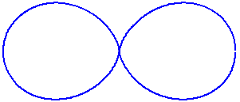
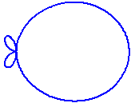
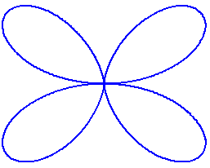
The directivity patterns of several two-element arrays consisting of two half-wave dipoles, with the separations and the phase difference of the currents are follows:
0
−π
0
0
–π/2
0
d = λ/2
d = λ/2
d = λ/4

Slide 42
Example. A linear four-element array consists of four parallel half-wave dipoles, as shown in figure. The separation between adjacent elements is half-wavelength, and the currents are in phase, but the amplitudes are , . Find the directivity factor in the plane being perpendicular to the elemental antennas.
Example
z
Solution: This is a non-uniform linear antenna array.
z
1
1
θ
However, elemental antennas ②and ③ can be considered as two half-wave dipoles with the same amplitude and phase for the electric currents.
2
2
y
y
x
3
3
4
4
This four-element array can be divided into two uniform linear three-element arrays.
The two three-element arrays consist of a uniform linear two-element array.

Slide 43
According to the principle of the pattern multiplication, the directivity factor of the four-element array should be equal to the product of the directivity factor of the three-element array by that of the two-element array, so that
Example
where

Slide 44
5. Radiation by Electric Current Loop
An electric current loop is formed by a wire loop carrying a uniform current, and a << λ , a << r .
Suppose the electric current is placed in infinite space with homogeneous, linear, and isotropic medium. It is convenient to choose a coordinate system so that the center of the current loop is at the origin and the loop is in the plane z = 0.
z
.
P
θ
r
a
φ
y
x

Slide 45
Since the structure is symmetrical about the z-axis, and the fields must be independent of the angle φ . For simplicity, the field point is taken to be in the xz-plane.
z
r
θ
a
φ′
r′
y
e_{φ′}
x
The vector magnetic potential A produced by the line electric current is
a
r′
y
And we find
φ′
e_{φ′}
-e_{x}
e_{φ′}
e_{φ}
φ′
x
where is the area of the loop.

Slide 46
From , we obtain
Using , we find
The electromagnetic fields produced by the electric current loop is a TE wave.

Slide 47
For the far-zone fields, , we only have and as
z
(-)?
S
ε , μ
E_{φ}
θ
r
H_{θ}
IS
y
And the directivity factor is
φ
x
z
The direction of maximum radiation is in the plane of the loop, and the null direction is perpendicular to the plane of the loop.
y

Slide 48
The radiated power P_{r} and the radiation resistance R_{r} are, respectively,
H_{φ} ( Element ) ~ E_{φ} ( Loop ) ; E_{θ} ( Element ) ~ H_{θ} ( Loop )
z
z
ε , μ
ε , μ
H_{φ}
E_{φ}
θ
θ
r
r
E_{θ}
H_{θ}
Il
y
IS
y
φ
φ
x
x

Slide 49
Example. A composite antenna consists of an electric current element and an electric current loop . The axis of the electric current element is perpendicular to the plane of the loop. Find the directivity factor and the polarization of the radiation fields.
Solution: Let the composite antenna be placed at the origin with the axis of the electric current element coincides with the z-axis.
z
E_{φ} = E₂
I₁
θ
E_{θ} = E₁
I₂
The distant electric field intensity produced by the electric current element is
y
x
φ
The distant electric field intensity produced by the electric current loop is

Slide 50
z
The resultant electric field in the far region is
E_{φ} = E₂
I₁
θ
E_{θ} = E₁
I₂
y
x
φ
The above two components are perpendicular to each other. But the two amplitudes are different and the phase difference is .
If the currents I₁ and I₂ are in phase, the resultant field will have elliptical polarization.
If the currents I₁ and I₂ have a phase difference of , the resultant field will have linear polarization.
The directivity factor of the composite antenna is still .

Slide 51
6. Principle of Duality
Duality
Up to now, no magnetic charge or current has been found to produce effects of engineering significance. However, the introduction of the fictitious magnetic charge and current will be useful for solving problems in electromagnetics.
Maxwell’s equations will be modified as follows:
where J _{m}(r) is density of magnetic current and ρ _{m}(r) is density of magnetic charge.
The magnetic charge conservation equation is

Slide 52
The resultant electromagnetic fields are divided into two parts:
and produced by electric charge and current, and
by magnetic charge and current.
Duality
Since the Maxwell’s equations are linear equations, they may be partitioned as follows:
Comparing them leads to the following relations:
These relations are called the principle of duality.

Slide 53
They reveal the relationship between the fields generated by the two types of sources and allow for the prediction of the fields of one source type using the equations obtained for the other.
Duality
For instance, from the far-zone fields of the z-directed electric current element Il
we can derive the equations for the far-zone fields of the z-directed magnetic current element I_{m}l as
The electric current loop placed in the xy-plane can be considered as a z-directed magnetic current element.

Slide 54
Duality
z
z
z
ε , μ
ε , μ
ε , μ
H_{φ}
E_{φ}
E_{φ}
θ
θ
r
θ
r
r
E_{θ}
H_{θ}
H_{θ}
Il
y
I_{m} l
y
IS
y
φ
φ
φ
x
x
x
Electric
Current
Element
Magnetic
Current
Element
Electric
Current
Loop

Slide 55
Maxwell’s equations in integral form will be modified as
Duality
The previous boundary conditions must be accordingly modified as
where is the density of the surface magnetic current, is the density of the surface magnetic charge, and is pointed to medium ② from medium ①
e_{n}
E_{2t}
B_{2n}
ε₂, μ₂
e_{t}
ε₁, μ₁
⊗
E_{1t}
B_{1n}

Slide 56
A medium with permeability μ → ∞ is called a perfect magnetic conductor, and no electromagnetic field can exist inside a perfect magnetic conductor. However, magnetic charge and current can be presumed to exist on the surface.
Duality
For the perfect magnetic conductor, we have
H
E
E
H
μ → ∞
σ→ ∞
p.e.c
p.m.c

Slide 57
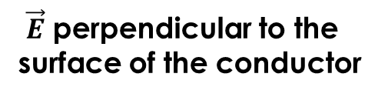
7. Principle of Image
Image
The method of image is also applicable to time-varying electro-magnetic fields for certain special boundaries.
The infinite planar perfect electric or magnetic conducting boundaries are discussed.
Assume that a time-varying electric current element Il is near to an infinite perfect electric conducting plane, and directed perpendicular to it.
$\vec{E}$ perpendicular to the surface of the conductor
Il
Il
ε μ
ε μ
σ→∞
ε μ
I'l'
In order to satisfy this boundary requirement, an image electric current element is placed at the image position, with
and .

Slide 58
A time-harmonic electric current is related to the local charge by . The charges are accumulated at two ends of the current element, and given by at the upper end and at the lower end.
Image
q
q
Il
Il
r₀
-q
E
-q
E₀
ε μ
ε μ
E–
ε μ
σ→∞
q'
E₊
I'l'
-q'
Since the whole space becomes an infinite homogeneous space, we can use the integral formulas for the vector and the scalar potentials to determine the fields.

Slide 59
The electric current element Il produces the electric field intensity as
Image
where
Similarly, we can find the electric field produced by the imaging electric current element as
where

Slide 60
q
At any points on the boundary, we have
Il
r₀
Image
-q
E₀
ε μ
E–
ε μ
We have assumed that
q'
E₊
I'l'
-q'
The direction of the resultant electric field is perpendicular to the boundary, and it shows that the effects of the image electric current element satisfy the given boundary conditions.
Because the direction of the image electric current element is the same as that of the original electric current element, this image electric current element is called a positive image.
For a horizontal electric current element, the image electric current element is a negative image.

Slide 61
The image relationships of the magnetic current element near an infinite perfect electric conducting plane are the converse of the above.
Image
？
σ →∞
μ →∞
？
Electric current element
Magnetic current element
From the point of the view of antenna array, the principle of image is related to that of a two-element antenna array.
The principle of image can also be used to account for the effect of the real ground on an antenna. However, it is applicable only if the antenna and the field point are sufficiently far away from the ground so that only the far-zone field needs to be considered.

Slide 62
The field in the upper half-space is resulted from direct wave E₁ and the reflected wave E₂ accounted for by the image, and they travel in the same directions. Hence, the resultant wave is the scalar sum of the direct and the reflected waves, giving by
Image
E₁
Directed
wave
r₁
Reflected wave
E₂
where R is the reflection coefficient at the ground surface.
Ground
r₂
Since the ground is placed in the far-zone field region of the antenna, the wave is TEM, and the reflection coefficient R can be approximated by that of a plane wave reflected by a plane boundary.
The effect of the ground on the antenna can be related to the solution of a non-uniform two-element array.

Slide 63
Example. A vertical electric current element Il is placed immediately on a ground plane. By the method of image, obtain the radiation field, the radiated power, and the radiation resistance. The ground is as infinite perfect electric conducting plane.
Example
E_{θ}
E_{θ}
ε₀ , μ₀
Il
θ
ε₀ , μ₀
Il
θ
σ → ∞
ε₀ , μ₀
Il
Solution: The image should be a positive one. Hence, the field in the upper half-space is equal to that produced by the electric current element of length 2l, then we find the radiation electric field as
In view of this, the field is doubled.

Slide 64
Because the grounded electric current element radiates energy only to the upper half-space, to find the radiated power P_{r} the integration of the energy flow density should be over the upper half-spherical surface only, so that
Example
And the radiation resistance R_{r} is
which is twice that without the ground plane.
A vertical wire on a tower is used in the MW broadcast station to enable listeners in all directions surrounding the station to receive the signal.
For medium waves, the ground can be approximated as a perfect electric conductor. Because the antenna is perpendicular to the ground, the ground will be helpful to increase the radiation.

Slide 65
The ferrite rod with a solenoid wound around it is used as a receiving antenna for the MW radio set. When it is used to receive the signal from the MW station, the ferrite rod should be placed horizontally and perpendicular to the direction of arrival of the electromagnetic wave.
Example
The horizontal half-wave dipole is usually used in the SW. Since the height above ground is comparable to the wavelength, the effect of the ground leads to a two-element antenna array.
By varying the height, a radiation direction with a certain angle of elevation can be obtained in the vertical plane perpendicular to the dipole.
γ

Slide 66
8. Principle of Reciprocity
Reciprocity
In a linear isotropic medium, there are two sets of sources
and with the same frequency in a finite region V .
These sources and the fields satisfy the following Maxwell’s equations:

Slide 67
Using , we obtain
Reciprocity
The above equations are called the differential and the integral forms of the principle of reciprocity, respectively.
Reciprocity leads to a relationship between two sets of sources of the same frequency and the fields they generate.
In view of this, if a set of sources and the fields are known, then the relationship between another set of sources and the fields can be found.

Slide 68
If we take the above integration over or only, we have
If there are no any sources in the closed surface S, we have
If the closed surface S encloses all sources, then the above equation still holds.

Slide 69
If the closed surface encloses all the sources a and b, then no matter what range of the closed surface S, as long as it encloses all of the sources, the surface integral is equal to the volume integral over .
Hence, the surface integral should be a constant.
In order to find this constant, we expand the surface S to the far-zone field region. Since the far-zone field is TEM wave, with
, where Z is the intrinsic impedance and is the unit vector in the direction of propagation, .
Substituting this result into the equation, two terms in the integrand of the surface integral will cancel each other. The surface integral is therefore zero, namely, the equation holds.

Slide 70
Hence, as long as the closed surface S encloses all sources, or all sources are outside the closed surface S, then the following equation will hold
which is called the Lorentz reciprocity relation.
Since the above equation holds, we have
Or it is rewritten as
which is called the Carson reciprocity relation.

Slide 71
The above reciprocity relations hold regardless of whether the space medium is homogeneous or not. We can prove that the Carson reciprocity relation still holds if there is a perfect electric or magnetic conductor in the region V.
σ→∞
μ→∞
S∞
Using the scalar triple product, we have
where and both represent the tangential components of the fields.

Slide 72
Consider the behavior of the far-zone fields, the boundary conditions for the perfect electric and magnetic conductors, the surface integration is still zero.
Then, in the region is enclosed by the closed surface S∞ in the far-field region and the surface of the p.e.c. or p.m.c. , Carson reciprocity relation still holds.

Slide 73
Example. By using reciprocity relationships, prove that a tangential electric current element near a finite-size perfect electric conductor has no radiation.
σ→∞
Solution:
Is the principle of image available?
The principle of reciprocity should be used.
Suppose the electric current element could produce an electric field E_{a} somewhere outside the conductor，then we can prove E_{a} = 0 。

Slide 74
Let another electric current element be positioned there, and it is placed along the direction of E_{a} . The source will produce an electric field E_{b} at , then we have
σ→∞
Considering Il = (JdS)l = JdV we obtain
However
Leading .
But ，
Only if .

Slide 75
9. Huygens Principle
The fields at the points on a closed surface enclosing the source can be considered as secondary sources, and they produce the fields at any point outside the closed surface.
These secondary sources are called Huygens elements.
E_{S} H_{S}
P
e_{n}
S
S
E_{P} H_{P}
z
V
e_{n}
S∞
Source
r – r '
Source
r'
P
r
E_{P} , H_{P} depend on all of E_{S} , H_{S} on S.
y
O
x
In order to derive the relationship between E_{P} , H_{P} and E_{S} , H_{S} , we construct a spherical surface S∞ with radius approaching infinity enclosing the whole region.

Slide 76
Taking some rigorous mathematical operations gives
e_{n}
S
z
V
e_{n}
S∞
Source
r – r '
r'
P
r
O
y
x
Where .
It is Green’s function in free-space.
The above equations are called Kirchhoff’s formulas. Since the equations are derived from the field components, they are called the scalar diffraction formula.
We have more mathematical expressions for Huygens principle.

Slide 77
The field at any point outside the closed surface depends on all Huygens elements on the closed surface.
E_{S} H_{S}
P
S
However, the contributions of the different Huygens elements will not be equal. Obviously, the main contribution is from the Huygens elements facing the field point.
E_{P} H_{P}
Source
Huygens principle means that wave propagation from the source to the field point is not along a line path only but over a certain region.
The geometrical optics principle considers that the propagation of the electromagnetic energy arriving at the field point is along a line path, and the ray is used to describe the propagation path.
This is valid only if the wavelength approaches zero, for which the propagation path is a line.

Slide 78

10. Radiations by Aperture Antennas
Aperture
Aperture
Aperture
Horn antenna
Parabolic antenna
Lens antenna
All of the antennas radiate the electromagnetic energy through a planar aperture, and they are called aperture antenna.
The aperture fields are solved first, then the radiated fields are found from the aperture fields. The problem of the aperture fields is called the internal problem, and the problem of the radiated fields is called the external problem.

Slide 79
The integration surface in any mathematical formula expressing Huygens principle must be closed. Hence, if it is used to calculate the radiation of the finite-size aperture fields, then error will arise.
Nevertheless, engineering experience shows that the error is not significant for the field in the front main lobe.
We first find the radiation of a Huygens element.
The field of a Huygens element can be written as
x
P
r
θ
z
Where ψ_{S 0} is the Huygens element at z = 0 .
y

Slide 80
For the far-zone fields, we can take
we find
1
θ
2
z
And the directivity factor is .
1
Any planar aperture field can be related to the sum of the fields produced by many Huygens elements with different amplitudes and phases.
If stands for a component of the aperture field in rectangular coordinate system, the far-zone field of all Huygens elements will have the same direction since the aperture is a plane. Taking the integration we find

Slide 81
Example. Obtain the radiation of a uniformly illuminated rectangular aperture of area .
Solution:
In rectangular coordinate system, a component of the aperture field is
x
P(x, y, z)
And we obtain
(x′, y ′,0)
r
P(r₀, θ, φ)
a
r₀
θ′
X
-b
θ
z
O
For the far-zone fields, we can take
y
b
E_{S 0}
-a
And , , .
We find

Slide 82
And the directivity factor is
In practice, the directivity patterns in two principal planes
and are usually used to represent the directivity of the aperture field.
We have two directivity factors are

Slide 83
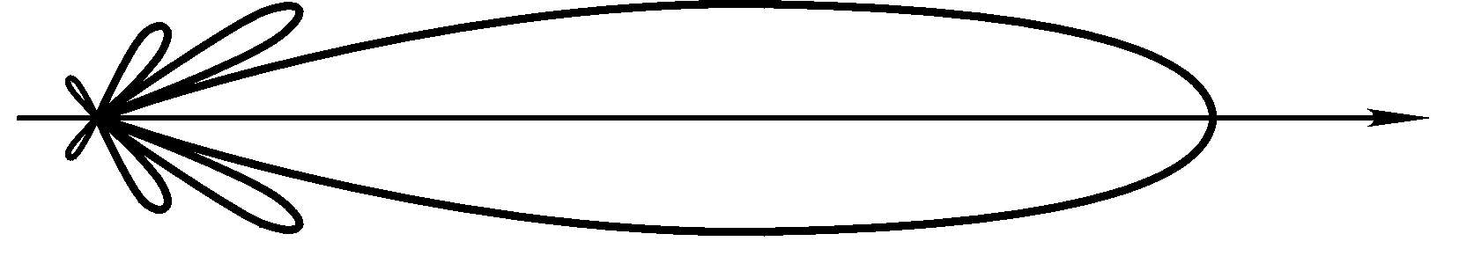
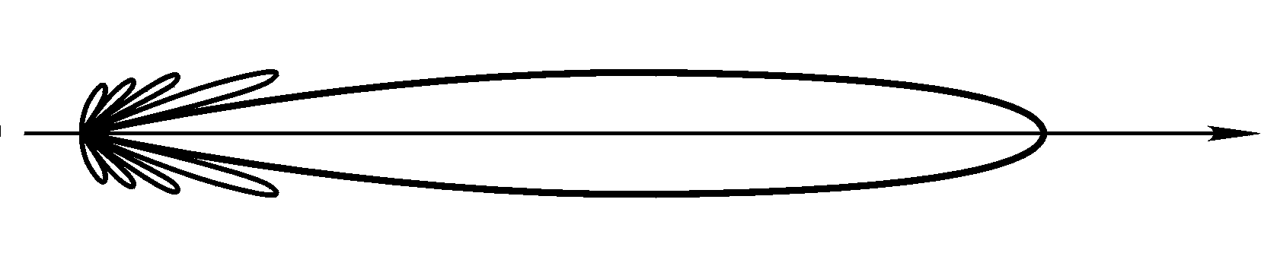
If , we have the directivity patterns as
x
a
f (θ, 0)
X
-b
O
z
y
b
-a
f (θ, )
The main lobe in the plane is narrower as a result of .
The half-power angle 2θ_{0.5} and the null-power angle 2θ₀ as
The directivity coefficient is
The larger the size of the aperture with respect to the wavelength is, the higher the directivity will be.

Slide 84
In general, the aperture field of an aperture antenna has nonuniform amplitude, but the phase is equalized or symmetrical about the center of the aperture.
In this case, the direction for maximum radiation is still in the front direction , but the directivity coefficient will be reduced.
In addition, considering the loss of the antenna, the gain of an aperture antenna can be written as
where ν is called the aperture efficiency.

Slide 85
Due to the non-uniformity in the amplitude of the aperture field, the variation in phase, the loss, the blockage of the feeder, and so on, the aperture efficiency will be further decreased.
In general,
A parabolic antenna of diameter 30 m used for satellite communication earth station with an aperture efficiency
at wavelength cm, a gain of dB can be obtained.

Slide 86

Thanks！

